Slide 1




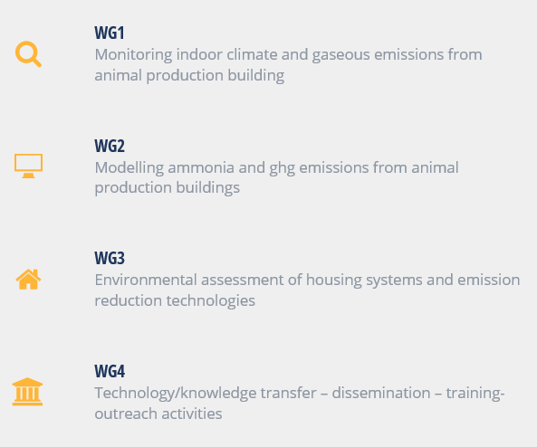


Main activities
Conferences
Workshops
STSM
Training Schools
Review papers

Slide 2
Training School on Modelling Ammonia and Greenhouse Gas Emissions from Animal Housing Systems
Dates
Tuesday April 16th & Wednesday April 17th (2019).
Venue
Gent University, campus Coupure of Faculty of Bioscience Engineering.
Coupure Links 653, 9000 Gent
Local organizers
Prof. Jan Pieters (Jan.Pieters@ugent.be, +32 9 264 61 88)
Dieter Iemants (Dieter.Iemants@ugent.be, +32 9 264 61 87)
Ir. Marelies Lauwers (Marlies.Lauwers@UGent.be, +32 9 264 62 01)
Dr. Peter Demeyer (Peter.Demeyer@ilvo.vlaanderen.be, +32 9 272 27 64)
Dr. Ozer Bagci (Ozer.Bagci@ilvo.vlaanderen.be, +32 9 272 28 03)

Slide 3
Trainers
Dr. André Aarnink, Livestock Research Group Wageningen UR (The Netherlands)
Dr. Ozer Bagci, Agricultural Engineering, ILVO (Belgium)
Prof. Thomas Bartzanas, Agricultural University of Athens (Greece)
Prof. Salva Calvet, Polytechnica University of Valencia (Spain)
Dr. Peter Demeyer, Agricultural Engineering, ILVO (Belgium)
Dr. Nico Ogink, Livestock Research Group Wageningen UR (The Netherlands)
Prof. Jan Pieters, Faculty of Bioscience Engineering, Ghent University (Belgium)
Dilya Willink, Leibniz-Institut für Agrartechnik und Bioökonomie , ATB (Germany)
Prof. Guoqiang Zhang, Civil and Architectural Engineering, Arhus University (Denmark)

Slide 4
Timetable for Tuesday April 16th
8:00-8:30 Welcome & scope of the training school (Jan Pieters & Peter Demeyer)
8:30-12:30 Session 1: Theory & approaches in emission process modelling (including 30min coffee break, contributions of ± 40min)
Effects of animal nutrition, excretion and behavior (André Aarnink)
Processes in urine and manure (Dilya Willink)
Mass transfer processes from emitting surfaces (Guoqiang Zhang)
Application of CFD (Ozer Bagci)
Methane emissions depending on manure management (Salva Calvet)
12:30-13:30 Lunch
Poster session during lunch of related research

Slide 5
13:30-17:30 Session 2: Modelling ammonia emissions and effect of emission reduction techniques for different animal categories (including 30min coffee break, contributions of ± 40min)
Methane emissions depending on manure management (Salva Calvet)
Pig houses (André Aarnink & Peter Demeyer)
Dairy cow houses (Nico Ogink)
Poultry houses (Ozer Bagci)
Goat & sheep houses (Thomas Bartzanas)
Predict Air Speed above the emission surface of Animal Housing (Guoqiang Zhang)
19:00 Diner in Ghent city
Restaurant Pakhuis, Schuurkenstraat 4, 9000 Gent

Slide 6
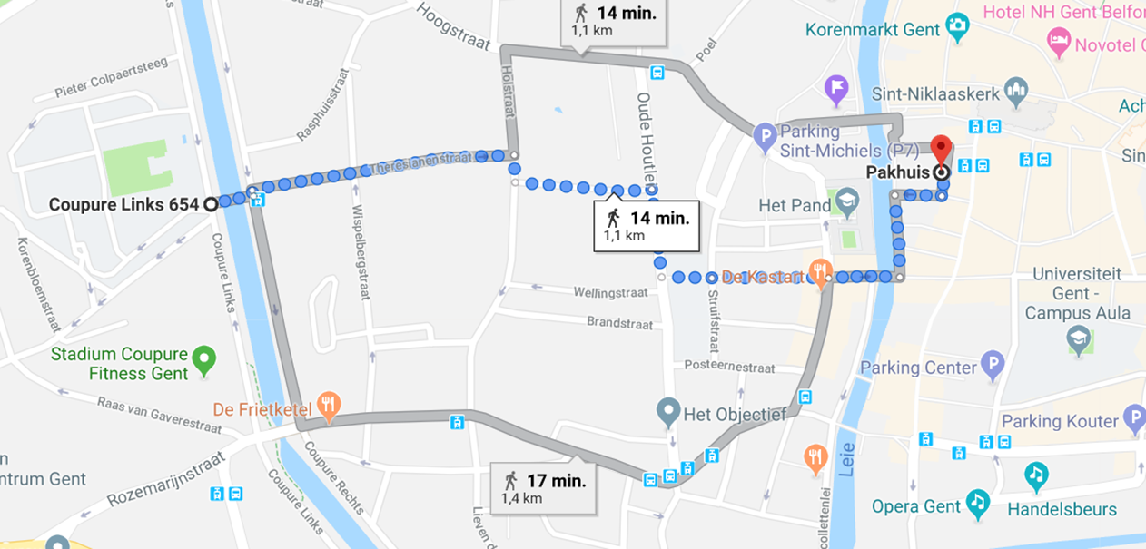
19:00 Diner in Ghent city
Restaurant Pakhuis, Schuurkenstraat 4, 9000 Gent

Slide 7
Files:
https://github.com/MarliesLauwers/COSTTS
Wifi:
Login : guestCostts
Password : 8egzYnH6

Slide 8
Timetable for Wednesday April 17th
8:30-12:30 Session 3: Interactive exercise session on designing low emission housing systems (including 30min coffee break)
Coordinators: Andre Aarnink, Jan Pieters, Ozer Bagci & Peter Demeyer
Contributors: all trainers
Starting points are given followed by an interactive exercises session:
Emissions from different floor types
Emissions per m2 manure area
Effects of different reduction options, e.g. reducing emitting area, dilution, acidification, scraping, manure belt
12:30-13:30 Lunch & end of the training school.

